Slide 1

STEM Salaries
Miles S. Marimbire

Slide 2
“Any sufficiently advanced technology is indistinguishable from magic”
- Arthur C. Clarke

Slide 3
Overview
The goal of the insights is to find the highest correlation to total yearly compensation, as well as find out what races have the highest total yearly compensation, how does working at a particular company affect total compensation and what races have the highest yearly compensation and how has compensation changed from the year.
This projects data source originates from levels fyi
There are 62,642 observations and 29 variables
The variables contains the total compensation, race, gender, education and many more

Slide 4
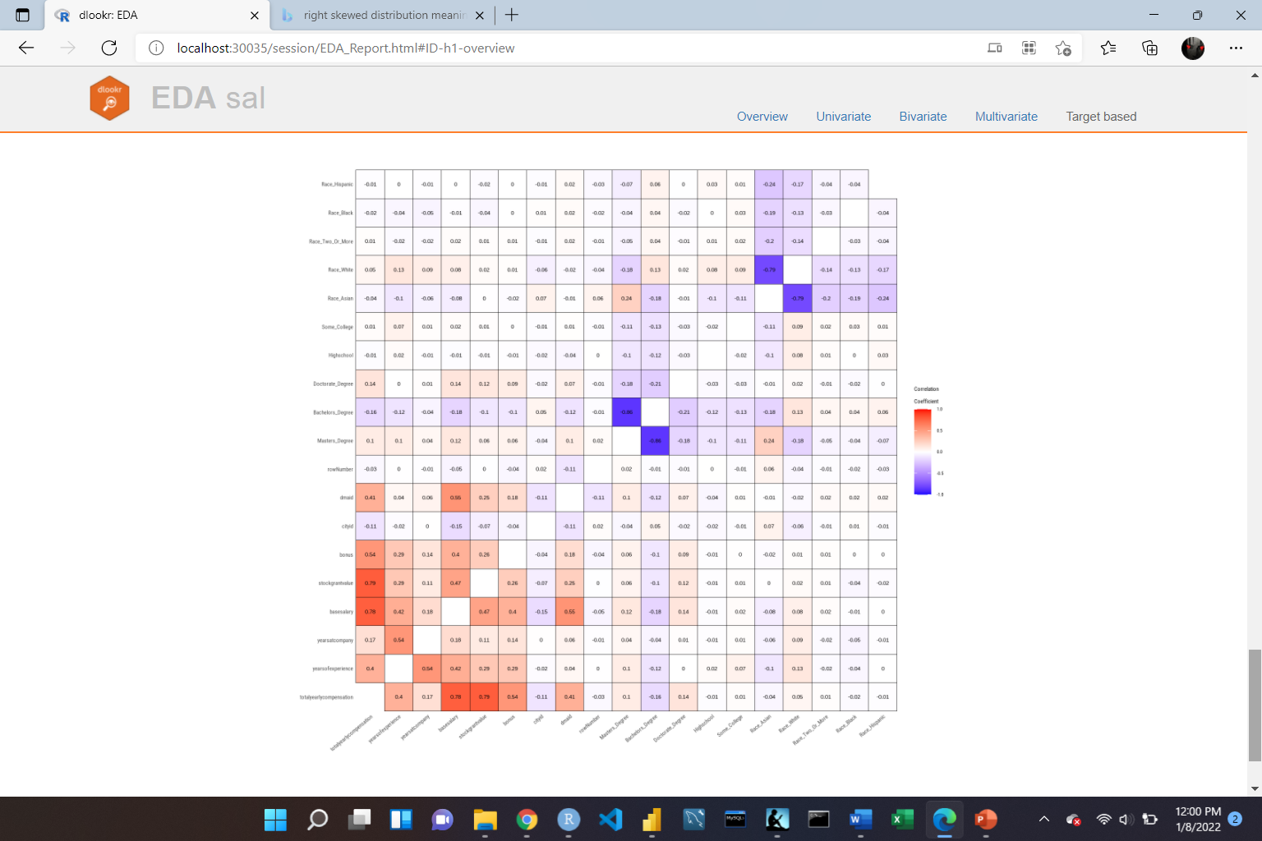
Correlation Matrix
The highest correlation to total yearly compensation is the stock grant value, followed with base salary having the second highest correlation to the total yearly compensation.

Slide 5
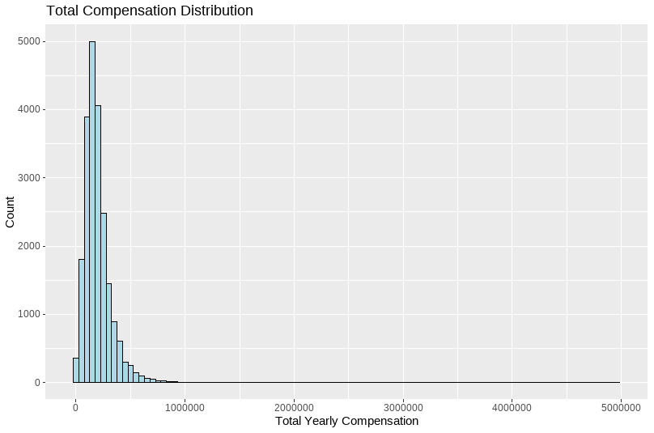
Total Yearly Compensation

Slide 6
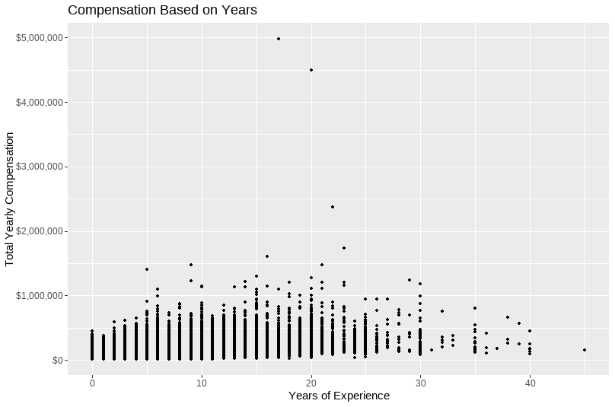
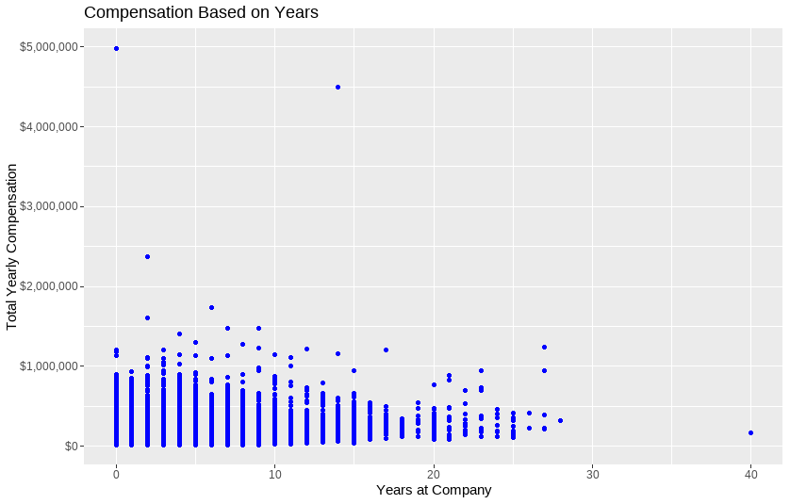
Compensation Based On Years of Exp & Years at Company

Slide 7
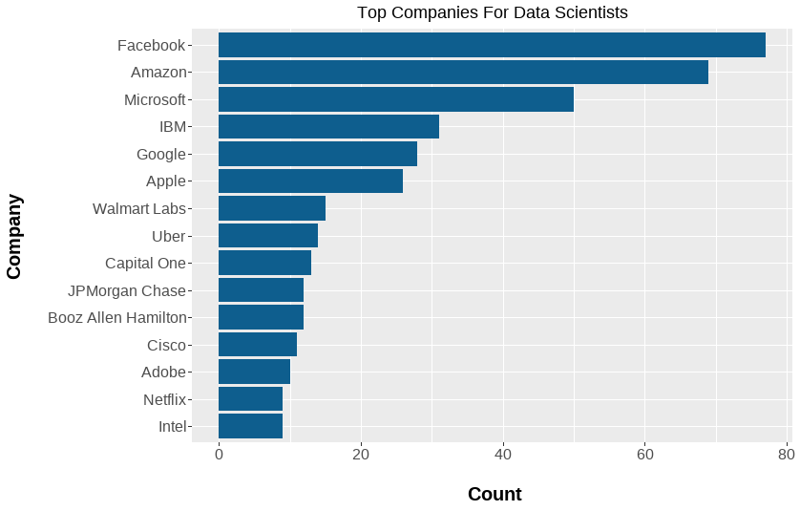
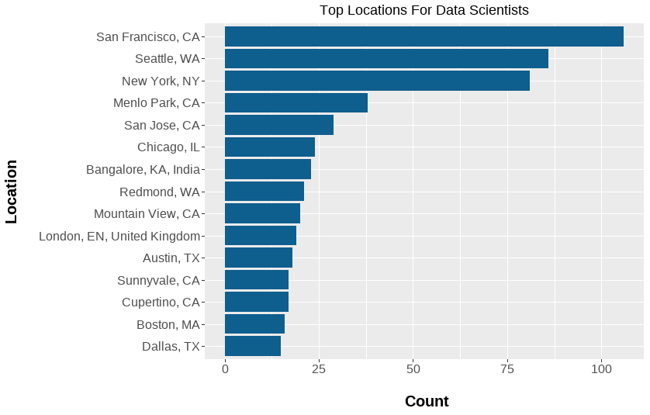
Top Companies & Location for Data Scientist

Slide 8
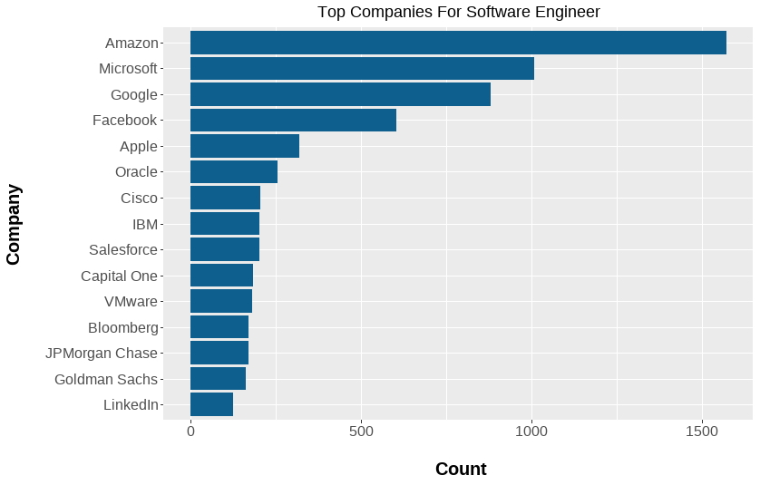
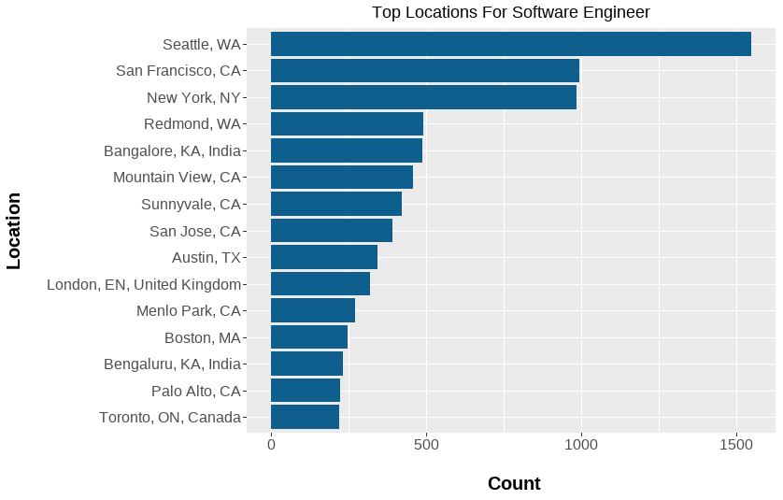
Top Companies & location for Software Engineers

Slide 9
Companies Affects on Total Yearly Compensation

Slide 10
Total Yearly Compensation Based on Race, Gender and Education

Slide 11
More Visualizations!
These were created by Power BI!
Total yearly compensation (1).pdf

